Slide 1
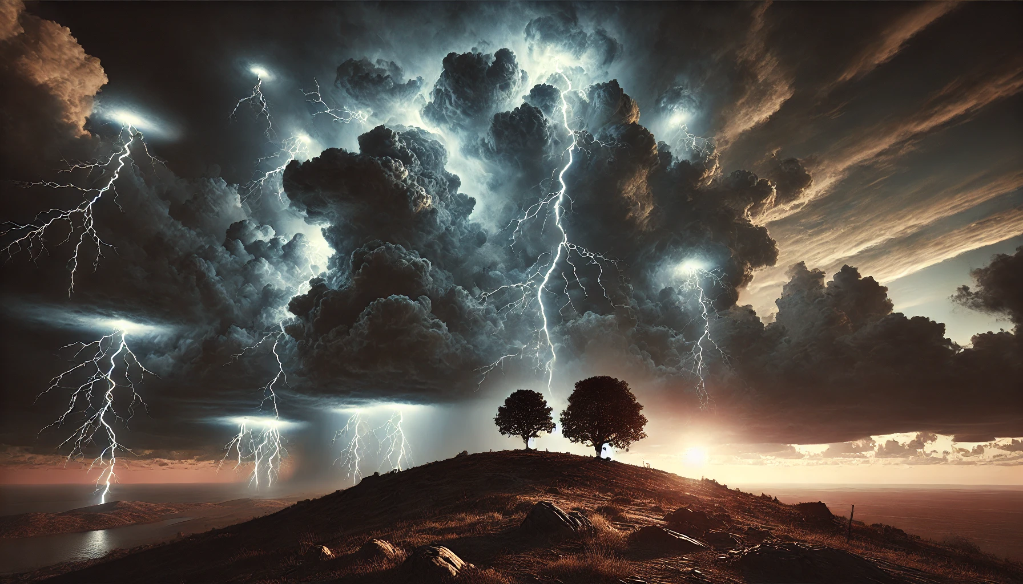
Stand Firm
Second Thessalonians

Slide 3
Th
Learning to Drive
Second Thessalonians 2:13-3:5

Slide 4
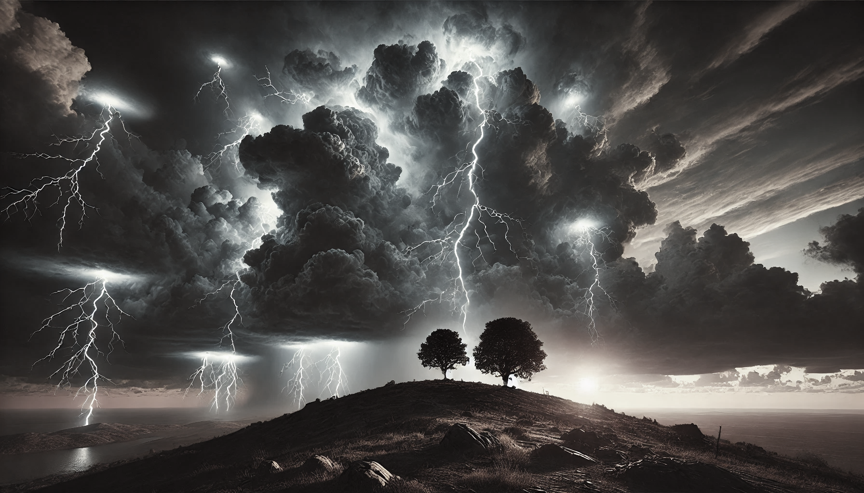
The Message of 2 Thess. 2:13-3:5
Paul encourages believers to be faithful to the truth, knowing how great their salvation is and confident that God is powerfully at work in them.

Slide 5
An Outline of 2 Thessalonians 2:12-3:5
* Reflect on your amazing salvation | 2:13-14
1. Thrive by STAYING grounded in the truth | 2:15
* Be confident of God’s work in you | 2:16-17
2. Thrive by PRAYING for the spread of the Gospel | 3:1-2
* Be confident of God’s work in you | 3:3
3. Thrive by OBEYING Christ’s commands | 3:4
* Be confident of God’s work in you | 3:5

Slide 6
Salvation, Past, Present and Future
In the PAST | We have been saved from the penalty of sin – past (2:13) | Justification
In the FUTURE | We will be saved from the presence of sin (2:14) | Glorification
In the PRESENT | We are being saved from the power of sin (2:15-3:5) | Sanctification

Slide 7
Three ways every Christian can thrive

Slide 8
1. Thrive by STAYING grounded in the truth

Slide 9
Thrive by STAYING grounded in the truth (2:15)
Knowing how glorious is our salvation (2:13-14)
Knowing God loves us (2:16)
Knowing God is working in us (2:17) [though we be distressed and weak]

Slide 10
Thrive by STAYING grounded in the truth (2:15)
By actively standing for the truth of God’s word (2:15)
By actively resisting and refuting false teaching (2:15)

Slide 11
2. Thrive by PRAYING for the spread of the Gospel

Slide 12
Thrive by PRAYING for the spread of the Gospel
(3:1-2)
Knowing that God is faithful (3:3)
Knowing God is working in us (3:3) [in the midst of a spiritual battle]

Slide 13
3. Thrive by OBEYING the commands of Christ

Slide 14
Thrive by OBEYING the commands of Christ (3:4)
Knowing God is working in us (3:5) [though trials assail us]
Knowing obedience and prayer aligns us with God’s will (3:5 see John 15:10)
Knowing that obedience and prayer allow God to do a greater work in us (3:5)

Slide 15
Big Idea
Take the brake off and speed up with God

Slide 16
Stand Firm
Second Thessalonians

